Slide 1
Geometric DeepLearning for subject-independent epileptic seizure prediction using scalp EEG signals

Slide 2
DOMAIN INTRODUCTION
Datamining, also known as text data mining, is the process of transforming unstructured text into a structured format to identify meaningful patterns and new insights.
Text is a one of the most common data types within databases. Depending on the database, this data can be organized as:
Structured data: This data is standardized into a tabular format with numerous rows and columns, making it easier to store and process for analysis and machine learning algorithms. Structured data can include inputs such as names, addresses, and phone numbers.
Unstructured data: This data does not have a predefined data format. It can include text from sources, like social media or product reviews, or rich media formats like, video and audio files.
Semi-structured data: As the name suggests, this data is a blend between structured and unstructured data formats. While it has some organization, it doesn’t have enough structure to meet the requirements of a relational database. Examples of semi-structured data include XML, JSON and HTML files.

Slide 3
ABSTRACT
Electroencephalogram (EEG) signal-based emotion recognition has attracted wide interests in recent years and has been broadly adopted in medical, affective computing, and other relevant fields. Depression has become a leading mental disorder worldwide. Evidence has shown that subjects with depression exhibit different spatial responses in neurophysiological signals from the healthy controls when they are exposed to positive and negative.
We focus our analysis in the main aspects involved in the recognition process (e.g., subjects, features extracted, classifiers), and compare the works per them.
We propose the emotional activation curve to demonstrate the activation process of emotions.
The primary objective of this project was to improve the performance of emotion recognition using brain signals by applying a novel and adaptive channel selection method that acknowledges that brain activity has a unique behavior that differs from one person to another and one emotional state to another.
The result shows that our proposed method significantly improves the accuracy of classifying depression patients emotion as positive and negative.

Slide 4
INTRODUCTION
DEPRESSION, as a common illness worldwide, is classified as a mood disorder and described as feelings of sadness or anger that interfere with a person’s everyday activities.
According to the World Health Organization, it is likely to be the leading global disease by 2030. Depression disorder is a pathological process that causes many symptoms, resulting in limited mental and physical functionality.
It is often accompanied by cognitive impairments, which may increase the risk of Alzheimer’s disease and suicide and accelerate cognitive decline.
The earlier depression is detected, the easier it is to treat. As a low-cost, non-invasive acquisition, and high temporal resolution technique, electroencephalography is widely used in neural systems and rehabilitation engineering.

Slide 5
OBJECTIVE
The main objective of this project was to improve the performance of emotion recognition using brain signals.
To effectively classify and predict the emotions.
To enhance the performance of overall prediction result.

Slide 6
EXISTING SYSTEM
In existing system, machine learning approaches to obtain the properties of physiological signals in the time, frequency, and nonlinear fields.
This method accomplishes greater precision in the classification of emotional states.
To recognize emotion from raw EEG signals to detect features next to the layer, and features were classified into low/high arousal, valence, and liking sequentially.
The feature extraction phase used a statistical approach based on specific features for different frequency ranges. Features chosen by this statistical approach exceeded univariate and multivariate features.
There are common and unique issues about the conducted approaches for emotion detection based on different classifiers.
The existing approach is high if real-time processing is implemented. Accordingly, there is a need to enhance the accuracy of emotion detection and classification and reduce the complexity of the utilized approaches.

Slide 7
DISADVANTAGES
Less effective.
Loss of Information.
Incorrect Prediciton Results.
Some specific problem in extract features.

Slide 8
PROPOSED SYSTEM
The proposed model shows the main steps for preprocessing stage, feature extraction, and classification.
To develop an effective EEG-based detection method for depression classification by employing spatial information.
In this process take EEG signal dataset to predict depression patients emotion as positive and negative. For that the first process is to pre-process the dataset to remove missing values and null values from the taken EEG dataset.
In order to classify different emotions, we need to record EEG signals from different subjects and then process them to extract different features. The data sets are made from the features and then we classify the dataset.
In this process we propose machine learning (KNN) and deep learning (LSTM) algorithms to classify the depression patient’s emotion as positive and negative.
Finally it improves the accuracy of classifying depression patients emotion as positive and negative.

Slide 9
ADVANTAGES
Highly effective.
Provide accurate prediction results.
It avoids data inconsistency.

Slide 10

ARCHITECTURE DIAGRAM
Select and View Dataset
Splitting Dataset into Train and Test
Dataset
Classification
Data preprocess
Prediction
Feature Scaling
Result Generation

Slide 11
FLOW DIAGRAM
Start
Select Dataset
View Data
Data Preprocessing
Classification using ML and DL Algorithm
KNN
LSTM
Data Cleaning and Label encoding
Prediction
Feature Selection
Result Generation
Data Visualization
Splitting Dataset into Training and Test Dataset

Slide 12
USECASE DIAGRAM
Data Selection
View Dataset
Data Preprocessing
Feature Selection
Splitting dataset into Train and Test
Regression
Prediction Result
ANALYST

Slide 13
CLASS DIAGRAM
DATASET
Select dataset ()
Import dataset ()
View dataset ()
DATA PREPROCESSING
Data Normalization ()
Label Encoding ()
FEATURE SELECTION
Dataset Splitting Train and Test
Feature Select ()
RESULT GENERATION
Result Generation ()
REGRESSION
Detection ()
Prediction ()

Slide 14
SEQUENCE DIAGRAM
DATA SELECTION & VIEW
PREPROCESSING
FEATURE
SELECTION
REGRESSION
RESULT GENERATION
Select path
Data Preprocess
Data normalize
Splitting Dataset into Training and Test Data
Import Dataset
Regression
Label encoding
Preview Data

Slide 15
ER-DIAGRAM
Data clean
Dataset Splitting
Select Data
Features
Preview Data
Label encoding
Set Path
DATA SELECTION & LOAD
DATA PREPROCESS
FEATURE SELECTION
RESULT GENERATION
REGRESSION
FEATURES
Survival
Damage

Slide 16
MODULES
Data Selection and Loading
Data Preprocessing
Feature Selection
Regression
Prediction
Result Generation

Slide 17
Data Selection and Loading
The data selection is the process of selecting the data for predicting the depression patient emotion from the EEG emotion dataset.
This is a dataset of EEG brainwave data that has been processed with our original strategy of statistical extraction.
The data was collected from two people (1 male, 1 female) for 3 minutes per state - positive, neutral, negative.
We used a Muse EEG headband which recorded the TP9, AF7, AF8 and TP10 EEG placements via dry electrodes.
Six minutes of resting neutral data is also recorded, the stimuli used to evoke the emotions.

Slide 18
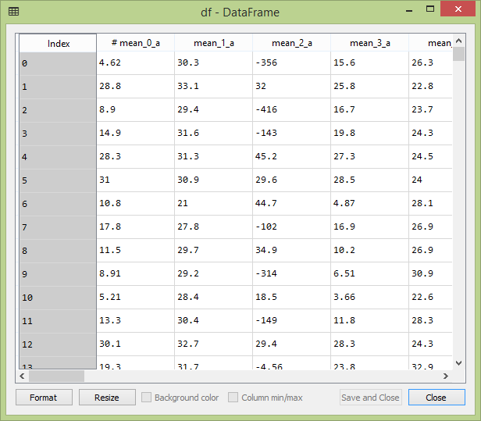

Slide 19
DATA PREPROCESSING
Data pre-processing is the process of removing the unwanted data from the dataset.
Data Normalization is used to scale the data of an attribute so that it falls in a smaller range, such as -1.0 to 1.0 or 0.0 to 1.0. It is generally useful for classification algorithms. Normalization is generally required when we are dealing with attributes on a different scale, otherwise, it may lead to a dilution in effectiveness of an important equally important attribute(on lower scale) because of other attribute having values on larger scale.
MIN-MAX Scalar transform features by scaling each feature to a given range. This estimator scales and translates each feature individually such that it is in the given range on the training set, e.g. between zero and one.

Slide 20
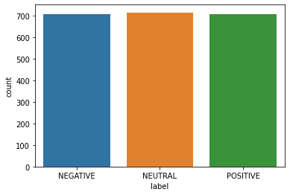
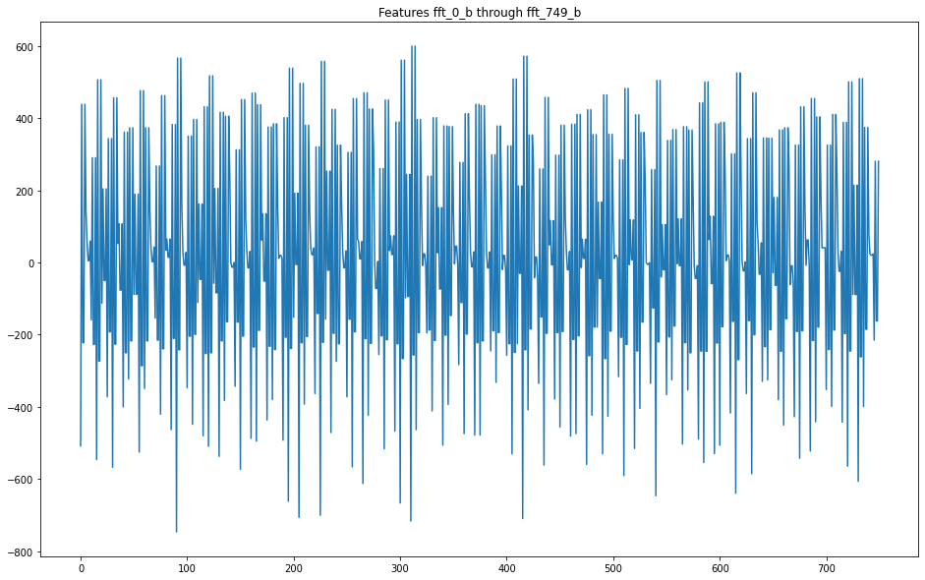

Slide 21
FEATURE SCALING
Feature Scaling is a technique to standardize the independent features present in the data in a fixed range.
If feature scaling is not done, then a machine learning algorithm tends to weigh greater values, higher and consider smaller values as the lower values, regardless of the unit of the values.

Slide 22
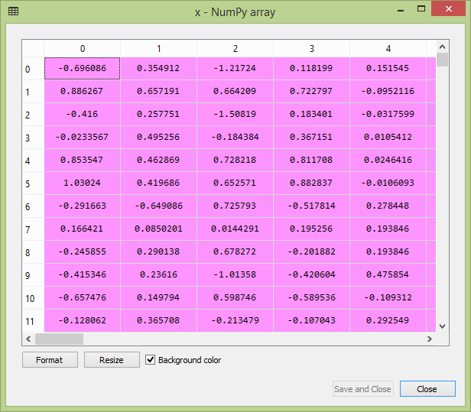
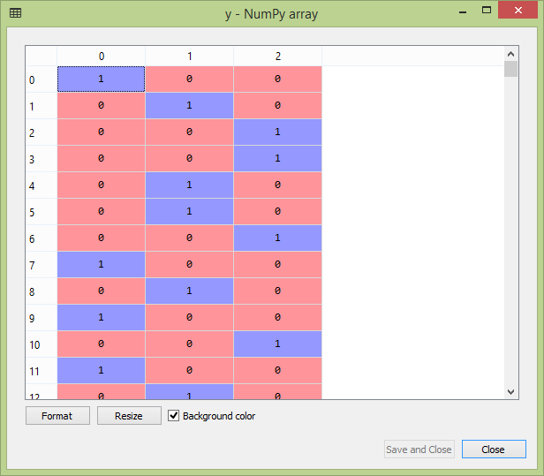

Slide 23
SPLIT DATA INTO TRAIN AND TEST
Data splitting is the act of partitioning available data into. two portions, usually for cross validatory purposes.
One. portion of the data is used to develop a predictive model. and the other to evaluate the model's performance.
Separating data into training and testing sets is an important part of evaluating data mining models.
Typically, when you separate a data set into a training set and testing set, most of the data is used for training, and a smaller portion of the data is used for testing.

Slide 24
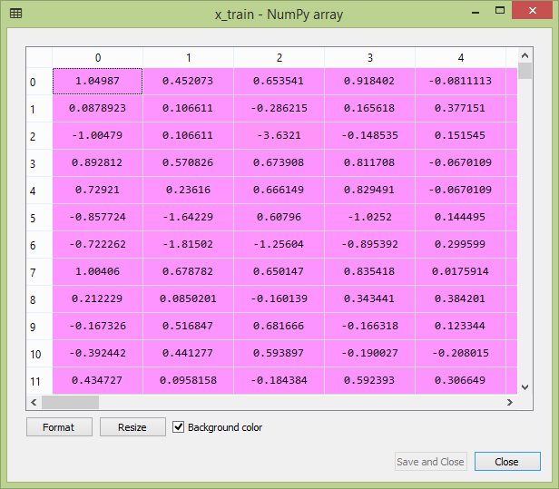
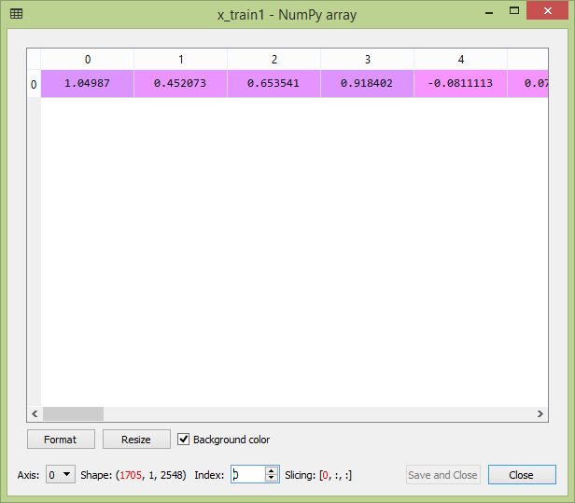

Slide 25
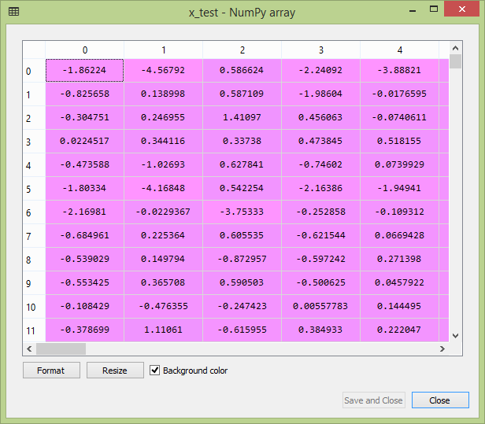
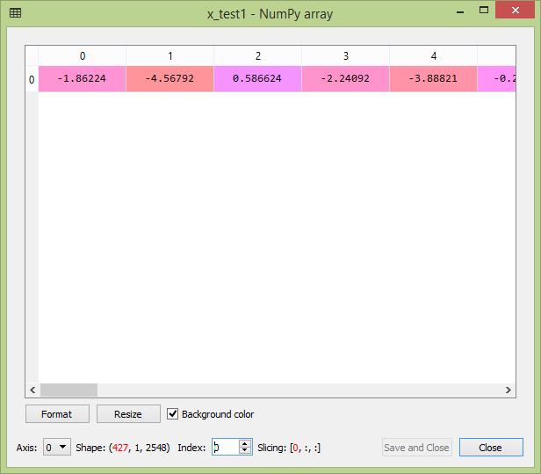

Slide 26
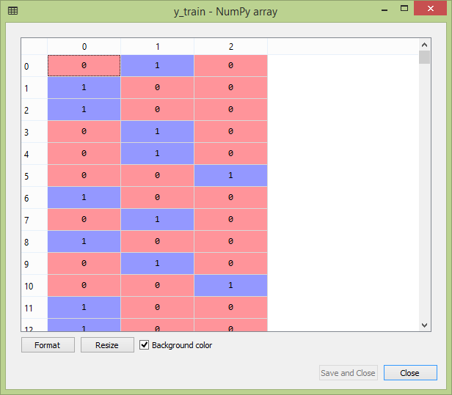
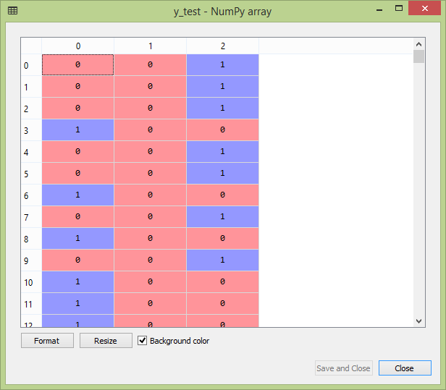

Slide 27
CLASSIFICATION
Classification is a process related to categorization, the process in which ideas and objects are recognized, differentiated, and understood. In this project, the KNN and LSTM classification algorithm is used for classifying the data.
K-NN algorithm assumes the similarity between the new case/data and available cases and put the new case into the category that is most similar to the available categories. It classifies a new data point based on the similarity. This means when new data appears then it can be easily classified into a well suite category by using K- NN algorithm.
Long short-term memory (LSTM) is an artificial recurrent neural network (RNN) architecture used in the field of deep learning. It can process not only single data points (such as images), but also entire sequences of data. The Long Short-Term Memory (LSTM) cell can process data sequentially and keep its hidden state through time.

Slide 28
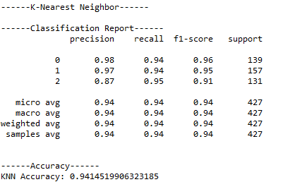
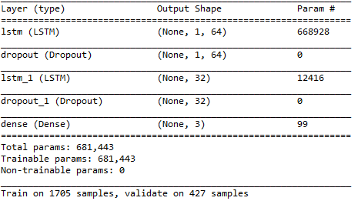
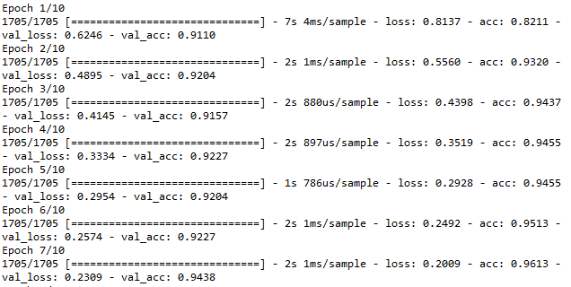
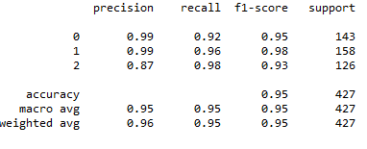
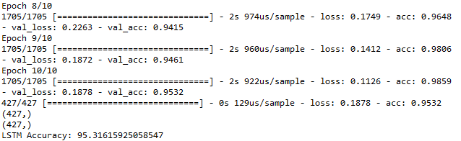

Slide 29
PERFORMANCE EVALUATION
The Final Result will get generated based on the overall classification and prediction. The performance of this proposed approach is evaluated using some measures like,
Accuracy
Precision
Recall
F-Measure

Slide 30
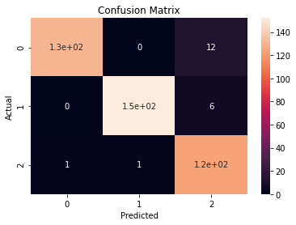

Slide 31
SYSTEM REQUIREMENTS
Software Requirements
Operating System : Windows 7
Language : Python
IDE : Anaconda – Spyder IDE

Slide 32
SYSTEM REQUIREMENTS
Hardware Requirements
Hard Disk : 1000 GB
Monitor : 15 VGA color
Mouse : Microsoft.
Keyboard : 110 keys enhanced
RAM : 4GB

Slide 33
LITERATURE SURVEY

Slide 34
Title | Year | Author | Methodology | Advantages | Disadvantages
Methods for classifying depression in single channel EEG using linear and nonlinear signal analysis | 2018 | M. Bachmann et al., | Depressive disorder is one of the leading causes of burden of disease today and it is presumed to take the first place in the world in 2030. Early detection of depression requires a patient-friendly inexpensive method based on easily measurable objective indicators. | Minimum volume ellipsoid model is proposed for performance degradation.. | Run to failure prediction is low

Slide 35
Title | Year | Author | Methodology | Advantages | Disadvantages
Brain wave frequency measurement in gamma wave range for accurate and early detection of depression | 2018 | J. Malik, M. Dahiya, and N. Kumari | The Global System of Mobile Communication (GSM) which debuted in Nigeria in August 2001 was greeted with much celebration as the country finally joined the League of the GSM nations, though after less economically buoyant African countries such as Botswana, Mozambique, Uganda and Tanzania. | It performs accurate classification of health state in comparison with other methods. | It is low in efficiency.

Slide 36
Title | Year | Author | Methodology | Advantages | Disadvantages
Seizure prediction in scalp EEG using 3D convolutional neural networks with an image-based approach | 2019 | A. R. Ozcan and S. Erturk | Epileptic seizures occur as a result of a process that develops over time and space in epileptic networks. In this study, we aim at developing a generalizable method for patient-specific seizure prediction by evaluating the spatio-temporal correlation in the features obtained from multichannel EEG signals. | More Reliable. | It is less in efficiency and not give perfect result.

Slide 37
Title | Year | Author | Methodology | Advantages | Disadvantages
Depression detection using relative EEG power induced by emotionally positive images and a conformal kernel support vector machine | 2018 | C.-T. Wu, D. G. Dillon, H.-C. Hsu, S. Huang, E. Barrick, and Y.-H. Liu | Electroencephalography (EEG) can assist with the detection of major depressive disorder (MDD). However, the ability to distinguish adults with MDD from healthy individuals using resting-state EEG features has reached a bottleneck. | High Efficiency. | Low in accuracy performance.

Slide 38
Title | Year | Author | Methodology | Advantages | Disadvantages
EEG-based mild depression recognition employing convolutional neural network | 2019 | X. Li et al. | This paper presents a remaining useful life (RUL) prognosis model for supercapacitors considering the aging conditions. The proposed model uses the particle filter to predict the posterior values of the aging indicators, i.e., capacitance and resistance. | Good in Performance. | Not Reliable

Slide 39
CONCLUSION
As a mood disease, depression is affecting an increasing number of people.
As a face-in-the-crowd task stimulus experiment based on frequency information filtering, time information feature extraction, and spatial information feature selection, we developed an improved EEG-based feature classification method employing spatial information, which is useful for the detection of patients with depression.
By employing the classification performance was significantly improved, which indicates that can enhance the spatial differences before feature extraction; however, we should be aware of the limitation of the datasets.

Slide 40
FUTURE ENHANCEMENT
In the future, we will continue to focus on correlation studies to obtain more detailed results.

Slide 41
PROBLEM STATEMENT
There has been much research done from EEG with different result. This different result has been due to diversity in different aspects of methods used in the research.
The diversities are mainly in aspects of emotion selection, experiment environment, techniques of data preprocessing and feature selection.
Due to all this factors, it is not easy to compare and chose the method which can be said as the best classifier.
Hence, there is always room for the development of better classifier suitable for specific application.

Slide 42
REFERENCES
[1] S. Avenevoli, J. Swendsen, J.-P. He, M. Burstein, and K. R. Merikangas, “Major depression in the national comorbidity survey–adolescent supplement: Prevalence, correlates, and treatment,” J. Amer. Acad. Child Adolescent Psychiatry, vol. 54, no. 1, pp. 37–44, Jan. 2015.
[2] M. Bachmann et al., “Methods for classifying depression in single channel EEG using linear and nonlinear signal analysis,” Comput. Methods Programs Biomed., vol. 155, pp. 11–17, Mar. 2018.
[3] I.-M. Spyrou, C. Frantzidis, C. Bratsas, I. Antoniou, and P. D. Bamidis, “Geriatric depression symptoms coexisting with cognitive decline: A comparison of classification methodologies,” Biomed. Signal Process. Control, vol. 25, pp. 118–129, Mar. 2016.
[4] J. Malik, M. Dahiya, and N. Kumari, “Brain wave frequency measurement in gamma wave range for accurate and early detection of depression,” Int. J. Adv. Res. Innov., vol. 6, no. 1, pp. 21–24, 2018.
[5] Y. Liu, H. Zhang, M. Chen, and L. Zhang, “A boosting-based spatialspectral model for stroke patients’ EEG analysis in rehabilitation training,” IEEE Trans. Neural Syst. Rehabil. Eng., vol. 24, no. 1, pp. 169–179, Jan. 2016.

Slide 43
REFERENCES
[6] A. R. Ozcan and S. Erturk, “Seizure prediction in scalp EEG using 3D convolutional neural networks with an image-based approach,” IEEE Trans. Neural Syst. Rehabil. Eng., vol. 27, no. 11, pp. 2284–2293, Nov. 2019.
[7] U. R. Acharya, V. K. Sudarshan, H. Adeli, J. Santhosh, J. E. W. Koh, and A. Adeli, “Computer-aided diagnosis of depression using EEG signals,” Eur. Neurol., vol. 73, nos. 5–6, pp. 329–336, 2015.
[8] B. Hosseinifard, M. H. Moradi, and R. Rostami, “Classifying depression patients and normal subjects using machine learning techniques and nonlinear features from EEG signal,” Comput. Methods Programs Biomed., vol. 109, no. 3, pp. 339–345, Mar. 2013.
[9] X. Li, B. Hu, S. Sun, and H. Cai, “EEG-based mild depressive detection using feature selection methods and classifiers,” Comput. Methods Programs Biomed., vol. 136, pp. 151–161, Nov. 2016.
[10] T. T. Erguzel, S. Ozekes, O. Tan, and S. Gultekin, “Feature selection and classification of electroencephalographic signals: An artificial neural network and genetic algorithm based approach,” Clin. EEG Neurosci., vol. 46, no. 4, pp. 321–326, Oct. 2015.

Slide 44
Thank You…

